Slide 1
Benchmarking C++ Applications
Alexander Radchenko

Slide 2
Background
Game development on various platforms for over 10 years
Playstation, Xbox, Wii, PC
Very different HW
Low latency request processing systems
High end x86_64 Linux servers
Performance matters in both domains

Slide 3
Games
Soft realtime systems
Performance is important to certain extent
Need to be fast enough
Consistent load
Occasional spikes
Throughput is the king

Slide 4
HFT
Low latency request processing systems
Performance = Money
Bursts
Latency is the king

Slide 5
How games do it
Start few months before release
Play through the game
Identify problem areas and get developers to fix them
Fix means:
Improve code performance
Change art
Repeat until performance is acceptable

Slide 6

How games do it: World of Tanks
Online MMO shooter
Fragmented platform
Wide range of HW
Old laptops with crappy drivers
High-end desktops
Everything in between

Slide 7
How games do it: World of Tanks
Categorize HW
Use recorded network traffic to replay client game
Measure performance on different HW
QA won’t allow release with performance drop outside of fixed threshold

Slide 8
HFT
Dedicated high end Linux HW
Speedlab environment to test performance
Lightweight tracing in speedlab and prod
Using time series DB to store captured data

Slide 9
Overview
Won’t be talking about micro benchmarking
Perf, Vtune etc
Lots of materials available
Highly recommend Chandler’s Carruth talk @ CppCon 2015 “Tuning C++…”

Slide 10
Overview
Will talk about lightweight tracing
Understanding application performance
Visualising and recognising patterns

Slide 11
Low Latency Fizzbuzz
https://github.com/phejet/CppMeetupDemo
C++ server which reads input data
Outputs Fizz, Buzz, FizzBuzz or just a number
How to make it fast ?
Measure first !!!

Slide 12
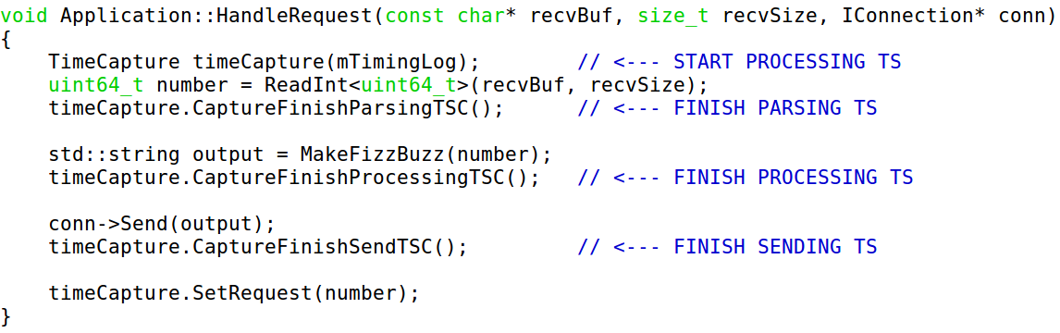
Request processing

Slide 13
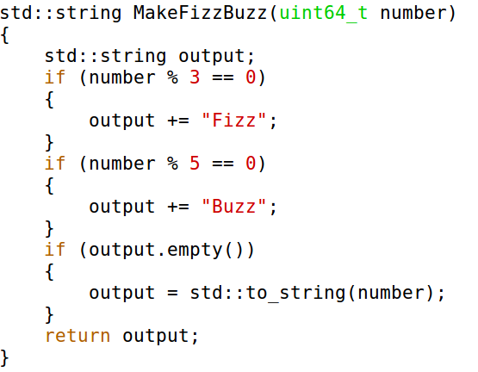
Fizzbuzz

Slide 14
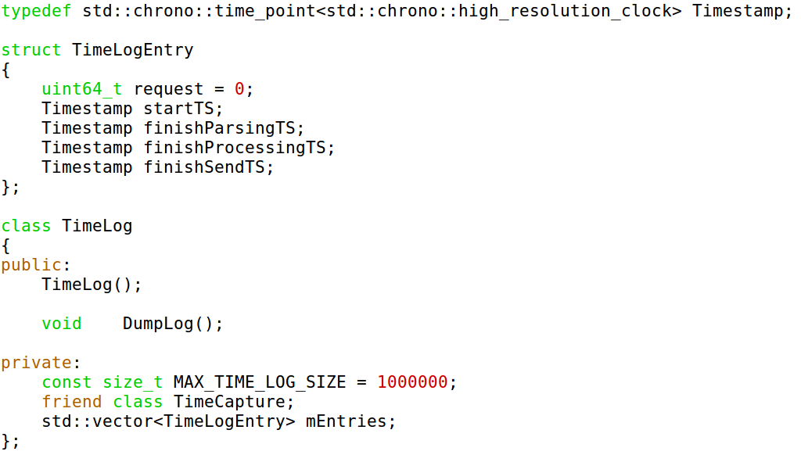
Timing

Slide 15
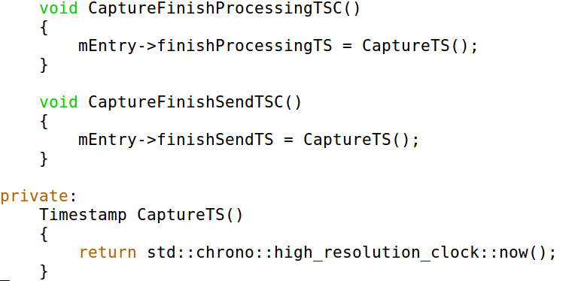
Timing

Slide 16
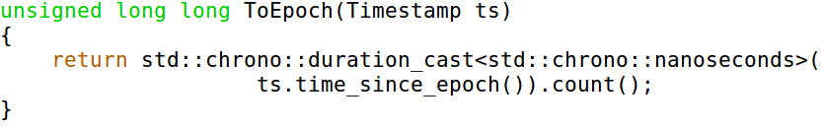
Using Epoch

Slide 17
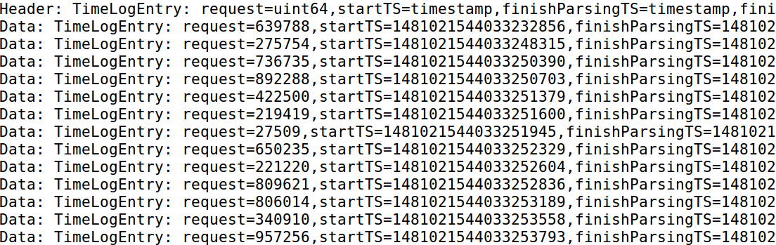
Timings output

Slide 18
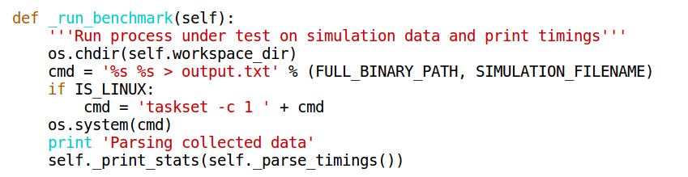
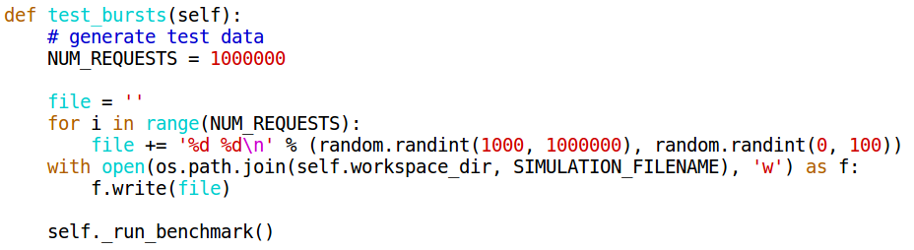
Macro benchmark

Slide 19
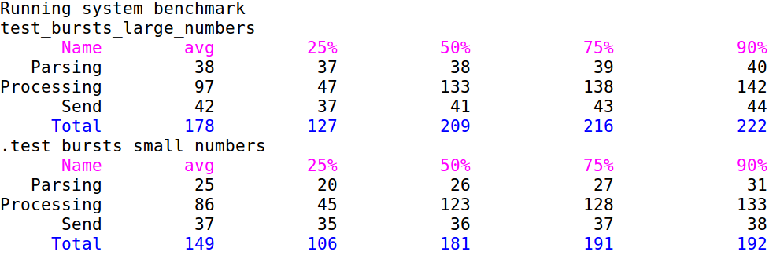
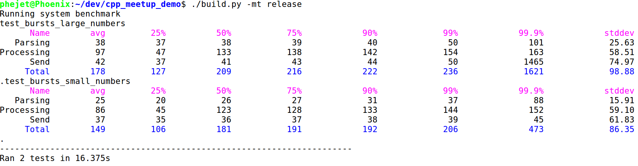
Quick feedback

Slide 20
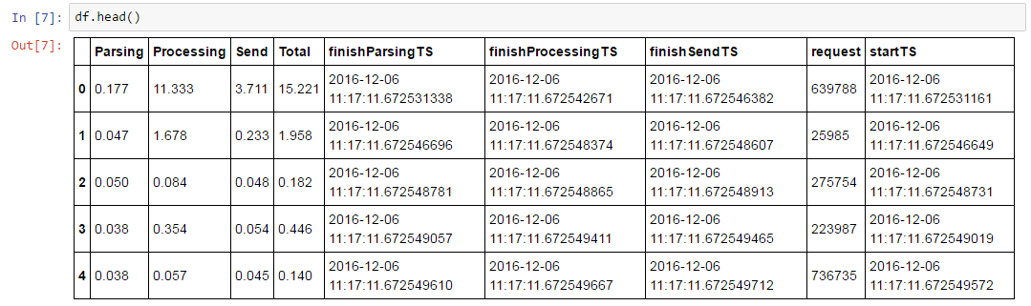
Jupiter notebook for in-depth analysis

Slide 21
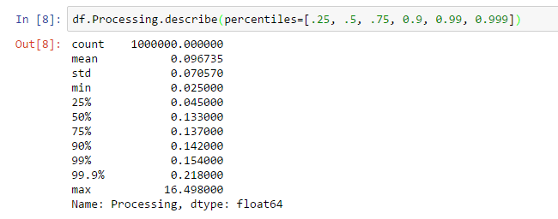
Jupiter notebook for in-depth analysis

Slide 22
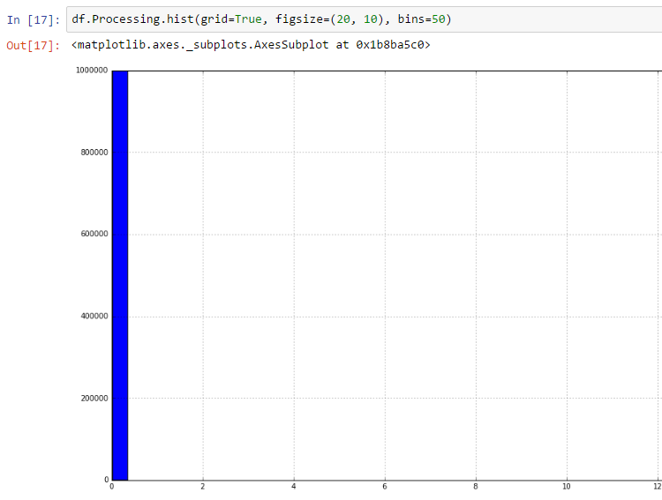
Jupiter notebook for in-depth analysis

Slide 23
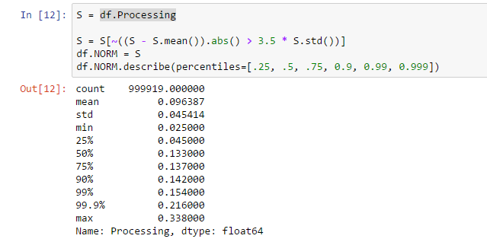
Jupiter notebook for in-depth analysis

Slide 24
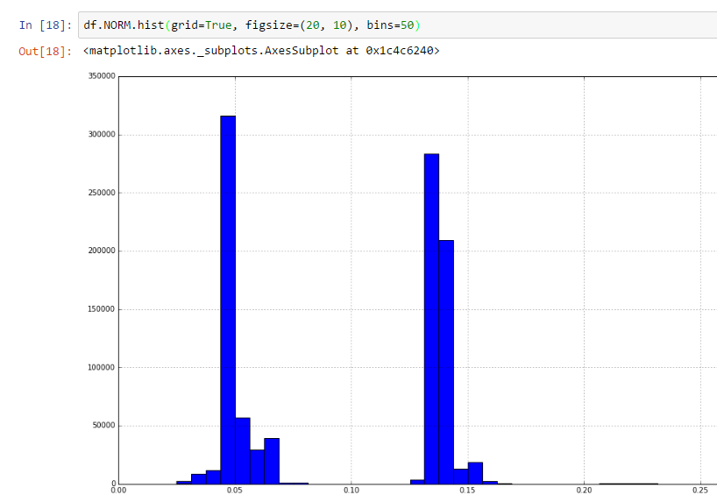
Jupiter notebook for in-depth analysis

Slide 25
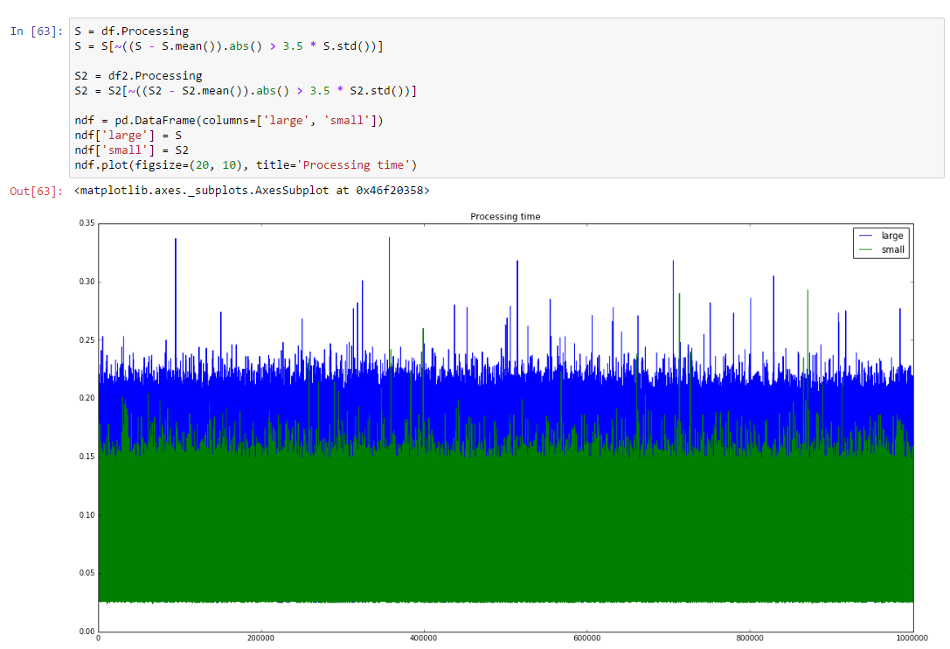
Jupiter notebook for in-depth analysis

Slide 26
Conclusion
Having a simple and reproducible way to measure performance is very important
Visualising performance data helps to understand it
Understanding is a necessary first step before optimisation

